Slide 1




CUSTOMER SATISFACTION &
SENTIMENT ANALYSIS
Ticketing System Review Dataset
Iftanul Ibnu Rochman

Slide 2

INTRODUCTION
The purpose of this analysis is to measure customer satisfaction with the ticketing system using CSAT, CES, and NPS metrics, while identifying key factors that influence user experience. In addition, this analysis examines customer sentiment through text reviews to gain deeper insights into how users perceive the system

Slide 3



DATA UNDERSTANDING
The initial dataset received contained 1,462 response rows from various ticket system users. These included:
General Information
  id survey: identifier for each survey
  date of survey: date of survey taken
  ticket system: The name of the ticket system being reviewed (e.g. Zoho Desk)
Survey Questions
  overall rating: Reviewer’s overall satisfaction (1–5)
  customer service: Satisfaction with customer support (1–5)
  features: Satisfaction with system features (1–5)
  value for money: Perceived value for money (1–5)
  ease_of use: Ease of use rating (1–5)
  likelihood to recommend: Likelihood to recommend the system (1–10)
  overall_text: Written review providing detailed feedback

Slide 4

DATA PREPROCESSING
The initial dataset consisted of 1,462 responses. After cleaning and validation, only 769 valid responses (52.60%) met the criteria for analysis.
1
Validate Rating
  Ensuring all ratings are within the correct range (1-5) and likelihood (1-10).
  Deleting rows with invalid values such as 0 and -1.
2
Deleting Incomplete Rows
  Removing responses that do not fill in important columns: overall_rating, ease_of_use, likelihood_to_recommend, and other rating attributes.
3
Review Text Cleaning
  Lowercase, trim whitespace, remove URLs, symbols, usernames, and empty text.
4
The dataset is divided into two parts:
  Rating Dataset → used for CSAT, CES, NPS analysis.
  Sentiment Dataset → contains valid reviews for sentiment analysis and wordclouds.

Slide 5

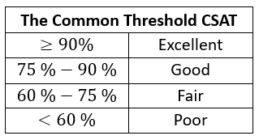
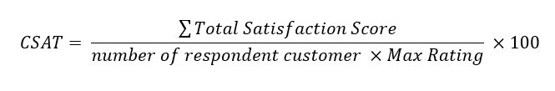



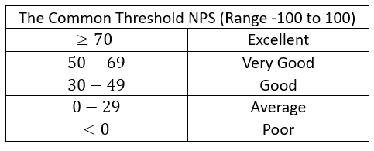

CUSTOMER SATISFACTION ANALYSIS METHODS
Customer Satisfaction Score (CSAT)
Measuring overall customer satisfaction level based on a 1-5 rating
Customer Effort Score (CES)
Measuring how easily customers use the system, using the ‘ease_of_use’ value (1–5).
Net Promoter Score (NPS)
Measuring customer loyalty based on 'likelihood to recommend’ (1-10), with categories:
  Promoter: 9–10
  Passive: 7–8
  Detractor: < 7

Slide 6





SENTIMENT ANALYSIS METHODS
Text Cleansing
  Convert text to lowercase
  Removing double spaces, numbers, and symbols
  Removing URLs, mentions, and irrelevant characters
  Deleting empty or meaningless text
Tokenization & Normalization
  Breaking down the sentence into tokens (words per line)
  Deleting tokens less than 3 characters
  Removing numbers, noise, and common stopwords
  Removing brand names (Zendesk, Freshdesk, Zoho) to prevent bias
Sentiment Classification
Using a sentiment scoring library (Vader) to categorize into:
  Positive
  Neutral
  Negative
Word Frequency & Wordcloud
Combining words based on frequency to create a word cloud:
  Calculating the frequency of word occurrences for each sentiment
  Choosing the top 50 words per category
  Creating a word cloud to visualize customer perceptions

Slide 7
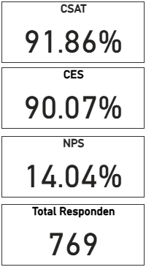
CUSTOMER SATISFACTION METRICS OVERVIEW
The overall customer satisfaction metrics indicate strong performance across key areas. The CSAT score of 91.86% shows that most users were satisfied with the system experience, while the CES score of 90.07% reflects that users found the system easy to use with minimal effort. The Net Promoter Score (NPS) of 14.04% indicates moderate advocacy, suggesting that although satisfaction is high, there is still room to increase user loyalty. These metrics were derived from 769 valid survey responses.
EXCELLENT
EXCELLENT
AVERAGE

Slide 8
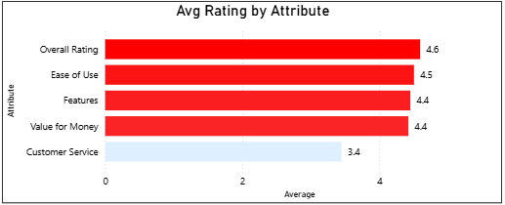

CUSTOMER EXPERIENCE BY KEY PRODUCT ATTRIBUTES
  The highest overall rating (4.6) indicates strong general satisfaction.
  Ease of Use (4.5) and Features (4.4) indicate the system is easy and functional for the majority of users.
  Value for Money (4.4) is considered to be commensurate with the benefits received.
  Customer Service (3.4) is the weakest attribute and is a key area influencing negative perceptions.

Slide 9
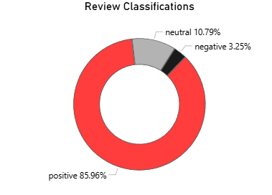

SENTIMENT DISTRIBUTION OVERVIEW
Analysis of the sentiment distribution from 769 reviews indicates that the majority of customers responded positively to the ticketing system. A total of 85.96% of the reviews fall into the positive category, reflecting a high level of satisfaction and a good user experience. Neutral reviews reached 10.79%, generally containing informative comments without emotional bias. Meanwhile, only 3.25% of reviews were negative, indicating room for improvement, although the scale is relatively small compared to the overall population.

Slide 10

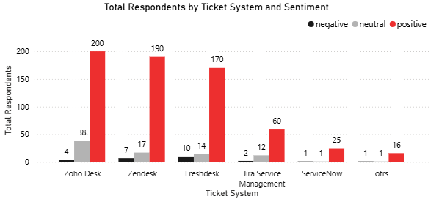
SENTIMENT DISTRIBUTION ACROSS TICKETING PLATFORMS
  Positive sentiment clearly dominates across all ticketing systems, indicating that the majority of users are satisfied with their experience.
  Zoho Desk and Zendesk received the highest number of respondents while maintaining a very high level of positive sentiment.
  Systems like ServiceNow and OTRS have a small review volume, so their sentiment interpretation needs to be cautious.
  Despite being small, negative sentiment still emerges, especially regarding issues with the use, performance, or expectations of specific services.

Slide 11

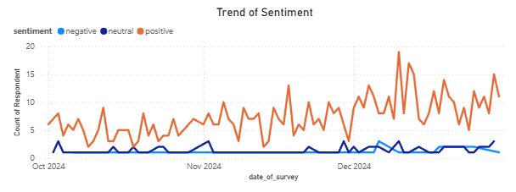
SENTIMENT TREND OVER TIME
  Positive sentiment consistently dominated from October to December 2024 with a steady upward trend.
  There was no significant negative spike, indicating no major issues triggering mass dissatisfaction.
  Neutral and negative sentiment remained at very low levels, reflecting a relatively homogeneous and stable user experience.
  The increase in positive sentiment at the end of December can be attributed to system improvements, feature enhancements, or specific service experiences.

Slide 12
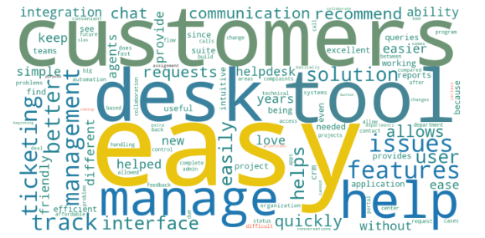

KEY THEMES FROM CUSTOMER REVIEWS
  Words like "easy," "help," "manage," "tool," and "features" emerged as the most dominant themes, indicating users' primary focus on ease of use and core functionality.
  The appearance of the words "customers," "desk," and "requests" reflects an operational context centered on customer service and ticket management.
  Words like "track," "interface," "quickly," and "solution" indicate that the speed and clarity of the process significantly impact the user experience.
  Almost all of the dominant words are positive or neutral in tone, supporting the sentiment analysis results that customer experience is generally very good.

Slide 13
CONCLUSION
This analysis shows that customer satisfaction with the ticketing system is at a very high level, evidenced by CSAT scores of 91.86% and CES 90.07%, reflecting an easy and satisfying user experience for the majority of respondents. Out of a total of 1,462 reviews, 769 valid respondents (52.60%) were used in the analysis to ensure the quality of the results. Although overall satisfaction is very good, an NPS score of 14.04% indicates that loyalty levels and referral potential are still not optimal. The sentiment analysis results show that 85.96% of the reviews are positive, however, the customer service area emerges as a weak point with a lower average score and a significant contribution to both neutral and negative reviews. Overall, the combination of numerical analysis, sentiment classification, per-platform distribution, and wordcloud provides a comprehensive overview of user perceptions and the key factors influencing their experience.

Slide 14
RECOMENDATION
  Improve the quality of customer service, as this attribute has the lowest score and is the biggest source of negative reviews.
  Optimize core features such as ease of use, tracking, interface, and ticket management, which are most often cited as factors of satisfaction.
  Strengthen user retention programs thru feature education, more structured onboarding, and improved reliability to increase NPS.
  Conduct regular sentiment monitoring to capture changes in user perception and address potential issues more quickly.
  Use word frequency analysis to prioritize product development, ensuring that innovations align with user needs and pain points.
  Evaluate the performance of each ticketing platform to identify the best aspects of products with high positive sentiment and replicate their best practices.

Slide 15
THANK YOU
Acces: Google Collab & Power BI

